Slide 1
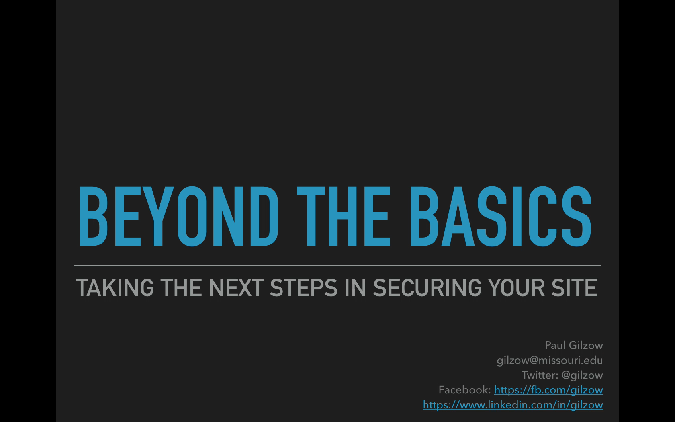
Notes:
mod_authz_core is apache 2.4 and later
Order Allow, Deny
means the default is to deny, and then “allow” for overrides, but then further enable denies to any allows

Slide 2
beyond the basics
taking the next steps in securing your site
Paul Gilzow gilzow@missouri.edu Twitter: @gilzow Facebook: https://fb.com/gilzow https://www.linkedin.com/in/gilzow
Notes:
How many manage people who admin/maintain wordpress sites?
How many directly admin wordpress sites?
Develop your own themes and plugins
How many are familiar with OWASP top 10?
How many use Apache? Nginx?
learned the hard way
sincere hope
apologize for jumping back and forth out of the presentation

Slide 3
BUT WAIT!
EVEN IF YOU KNOW NOTHING ABOUT SECURITY, I PROMISE YOU’LL GET SOMETHING FROM THIS PRESENTATION!
Notes:
knowing you are a target is a first step.
simply being aware.
understanding the platform you are on.
believing security is essentially and acting on it
an ounce of prevention is worth of pound of cure;
“we either take preventative measures now, or much more difficult and expensive reactive measures later” - The Black Report

Slide 4
beyond the basics
taking the next steps in securing your site
Paul Gilzow gilzow@missouri.edu Twitter: @gilzow Facebook: https://fb.com/gilzow https://www.linkedin.com/in/gilzow
Notes:
How many manage people who admin/maintain wordpress sites?
How many directly admin wordpress sites?
Develop your own themes and plugins
How many are familiar with OWASP top 10?
How many use Apache? Nginx?
learned the hard way
sincere hope
apologize for jumping back and forth out of the presentation

Slide 5
Access Denied
KEEPING YOUrself off an Attacker’s radar
Paul Gilzow gilzow@missouri.edu Twitter: @gilzow Facebook: https://fb.com/gilzow https://www.linkedin.com/in/gilzow
Notes:
How many manage people who admin/maintain wordpress sites?
How many directly admin wordpress sites?
Develop your own themes and plugins
How many are familiar with OWASP top 10?
How many use Apache? Nginx?
learned the hard way
sincere hope
apologize for jumping back and forth out of the presentation

Slide 6
a little about me
With the University of Missouri since 2000
Programmer/Analyst since 2005
Developing WordPress sites since 2009
Maintainer and current author of the wpDirAuth plugin
Author and maintainer of a MizzouMVC, a rapid-theme-development framework

Slide 7
Tl;DSWTGMC Summary
(Too Long; Didn’t Stay, Went to Get More Coffee)
Implicitly Deny
Defense-in-Depth

Slide 8
who i’m not
Security Expert
Professional Hacker
Notes:
show what information wordpress freely gives away about itself
show how easy it can be to take control of a WordPress site
Everything we’ll cover is widely available on the Internet, and easily findable
Important to remember that we learn today might not be relevant a year from now

Slide 9
BEYOND THE BASICS
Why do attackers target you
Why WordPress is an attractive target
Current state of WordPress security
WPScan
Counter-measures
Notes:
show what information wordpress freely gives away about itself
show how easy it can be to take control of a WordPress site
Everything we’ll cover is widely available on the Internet, and easily findable
no special skills, no ski mask
One layer, defense-in-depth

Slide 10
Current State of Web Application security
44% of sites had at least one vulnerability every day of the year¹
Average of 14 vulnerabilities per site, 7 of those serious¹
Took an average of 5 months to remediate issues¹
1 - White Hat Security Web Applications Security Statistics Report 2016
Notes:
no newer report. update to include all industries

Slide 11
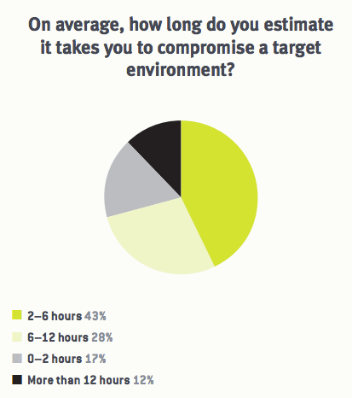
Current State of Web Application security cont.
1. Nuix White Paper, The Black Report 2017: https://www.nuix.com/download/White%20paper%20-%20The%20Black%20Report
Notes:
60% 6 hours or less
88% in 12 hours or less

Slide 12
Types of Attacks
Opportunistic
Targeted
Notes:
opportunistic not targeting you, just low hanging fruit
opportunistic noisier
targeted stealthy

Slide 13
Why do attackers target you
Your site resources
Your domain
Your SEO reputation
Your visitors
Notes:
But my site is just brochureware!
*most* attacks are automated and opportunistic
Attackers aren’t targeting you, they’re targeting the resources your site has access to
HOWEVER, Panama Papers Breach, most likely via rev slider and then moved laterally into the email system

Slide 14
Why wordpress is an attractive target
Market share
Open Source
Extremely easy to set up and get running, not so easy to secure
Anyone can create and submit a theme/plugin
Notes:
Market share
Open Source
Anyone can create and submit a theme/plugin
Extremely easy to set up and get running, not so easy to secure
With popularity, comes a price.
Economic return for attacking wordpress.

Slide 15
“What makes WordPress so insecure is that it's highly extensible and easy to use; wordpress security issues revolve almost entirely around this extensibility and easyness of use.”
Tony Perez, @perezbox

Slide 16
current state of wordpress security
Most compromises occur through
vulnerable plugins and themes
Weak passwords
Wordpress out-of-date
Notes:
Most compromises occur through
vulnerable plugins and themes
Weak passwords
Wordpress out-of-date
Vulnerability categories
Injections
Remote File Inclusion and/or Execution
Brute force and/or dictionary attacks
vast majority of attacks now are automated and opportunistic
biggest issue is education and awareness
better about removing vul plugins from repo, still have work to do on verifying fixes

Slide 17
As an owner/maintainer of a wordpress site, it is your responsibility to be paranoid

Slide 18
So What DO we DO?
Notes:
knowing you are a target is a first step.
simply being aware.
understanding the platform you are on.
believing security is essentially and acting on it
an ounce of prevention is worth of pound of cure;
“we either take preventative measures now, or much more difficult and expensive reactive measures later” - The Black Report

Slide 19

Defense-in-depth

Slide 20
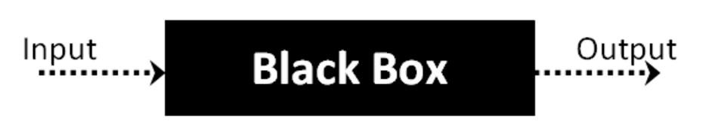
Black Box Testing
Automated application security testing that views the state of an application from the outside looking in
Assumes no knowledge of internal code structure or paths
Notes:
not *really* blackbox; more like graybox.

Slide 21
Available Tools
CMSmap https://github.com/dionach/CMSmap
Droopescan https://github.com/droope/droopescan
Recon-NG https://bitbucket.org/LaNMaSteR53/recon-ng
WPScan http://wpscan.org/
Notes:
NOT AN EXHAUSTIVE LIST
Mention passive mode and bring up the next slide THEN scan wpcampus.org

Slide 22
WPScan
Passive (non-intrusive) Scan
Robots.txt
Interesting headers
Multisite
Must-use plugins
Xml-rpc
Wordpress version
Plugins/themes
Notes:
Greybox
included in most pen tool kits
Updated, actively maintained
sponsored by sucuri
Passive Scan
Robots.txt
Interesting headers
Multisite
Must-use plugins
Xml-rpc
Wordpress version
Plugins/themes
passive mode will look like any regular user browsing the site
Mention false positives, humans always needed
Interesting headers: server, php version, CDN,

Slide 23
WpScan
Active scan
Scans for signs of vulnerable plugins
Scans for signs of vulnerable themes
Scans for signs of timthumb
Attempts to enumerate user account names
Notes:
Active scan
Scans for signs of vulnerable plugins
Scans for signs of vulnerable themes
Scans for signs of timthumb
Attempts to enumerate user account names

Slide 25
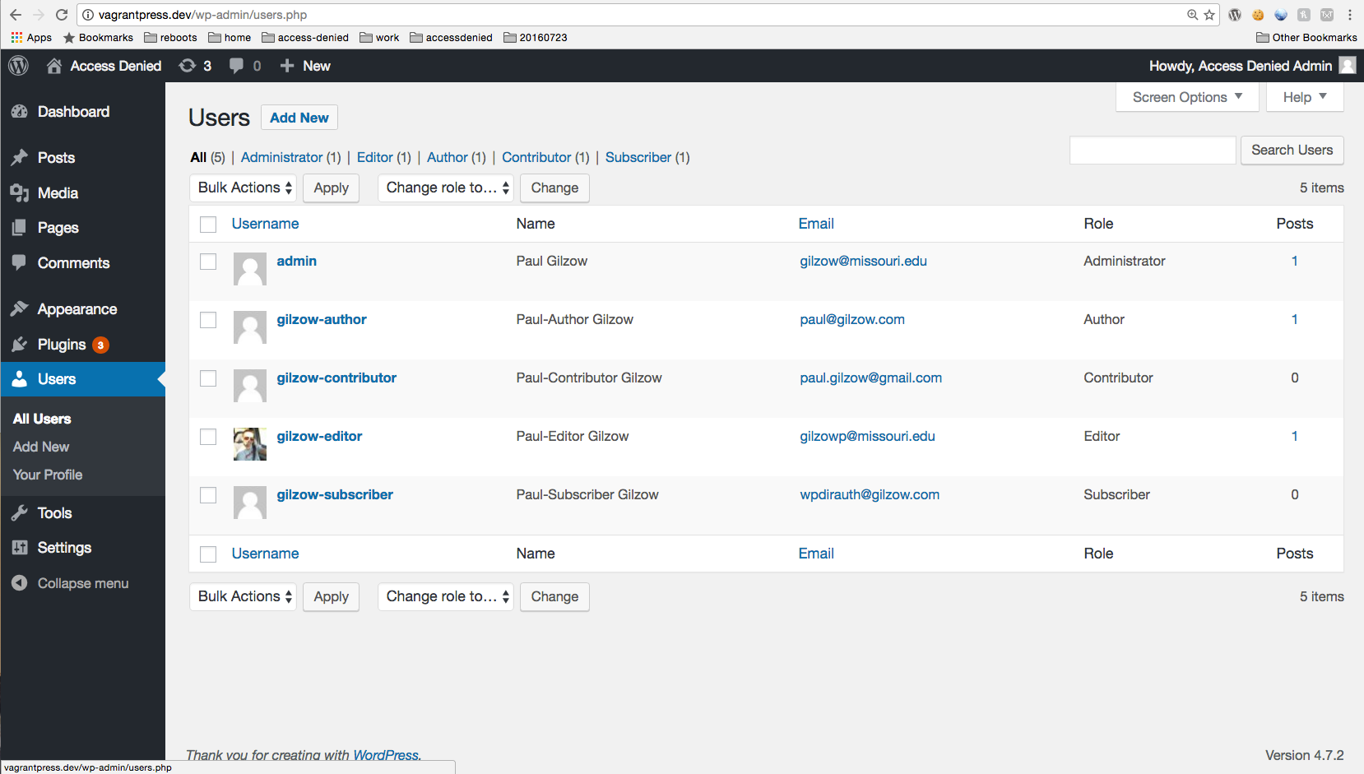

Slide 26
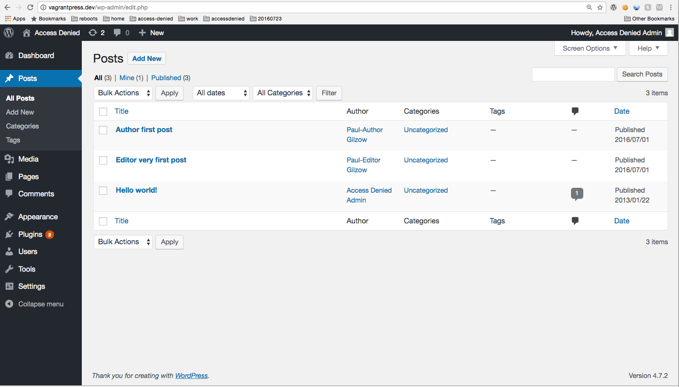

Slide 27
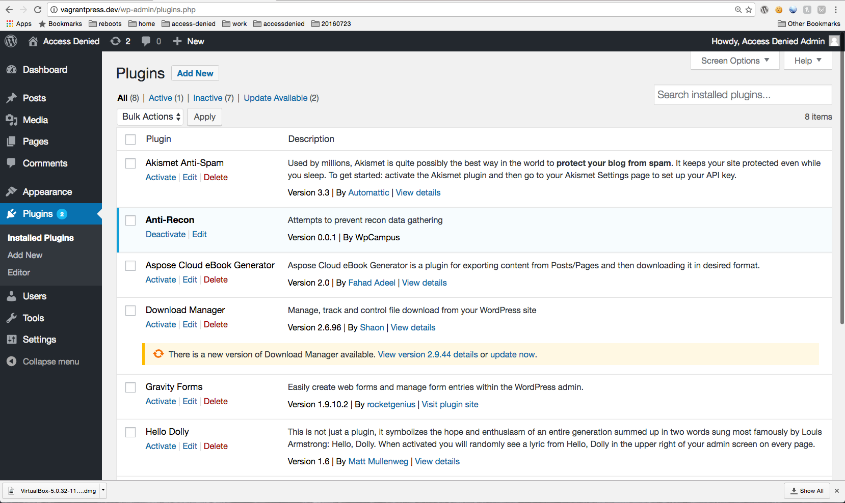



Slide 28
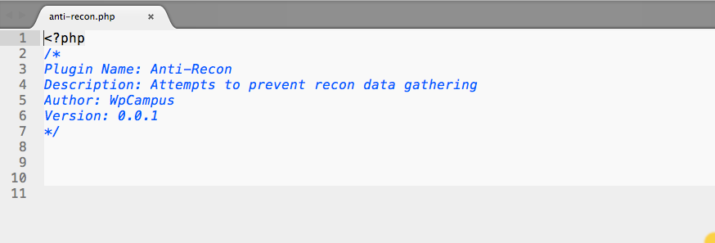

Slide 29
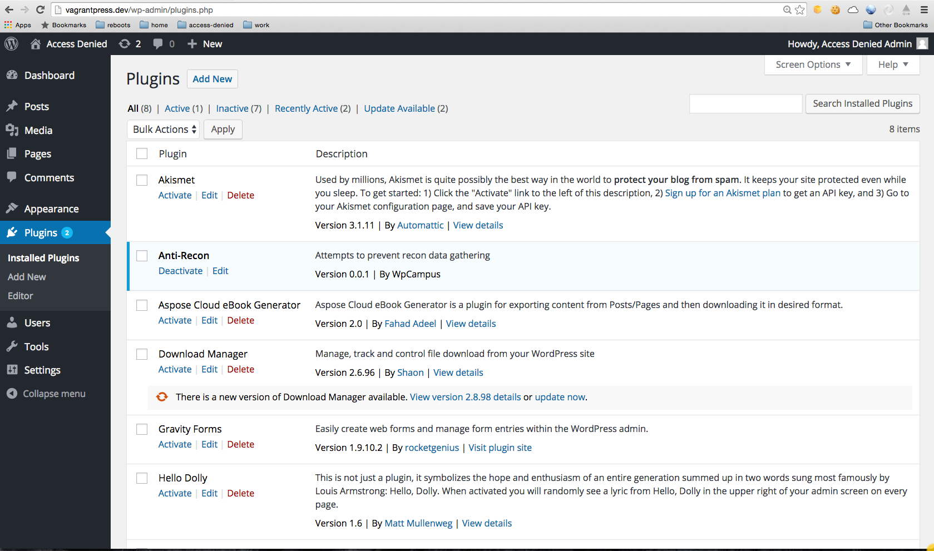

Slide 30

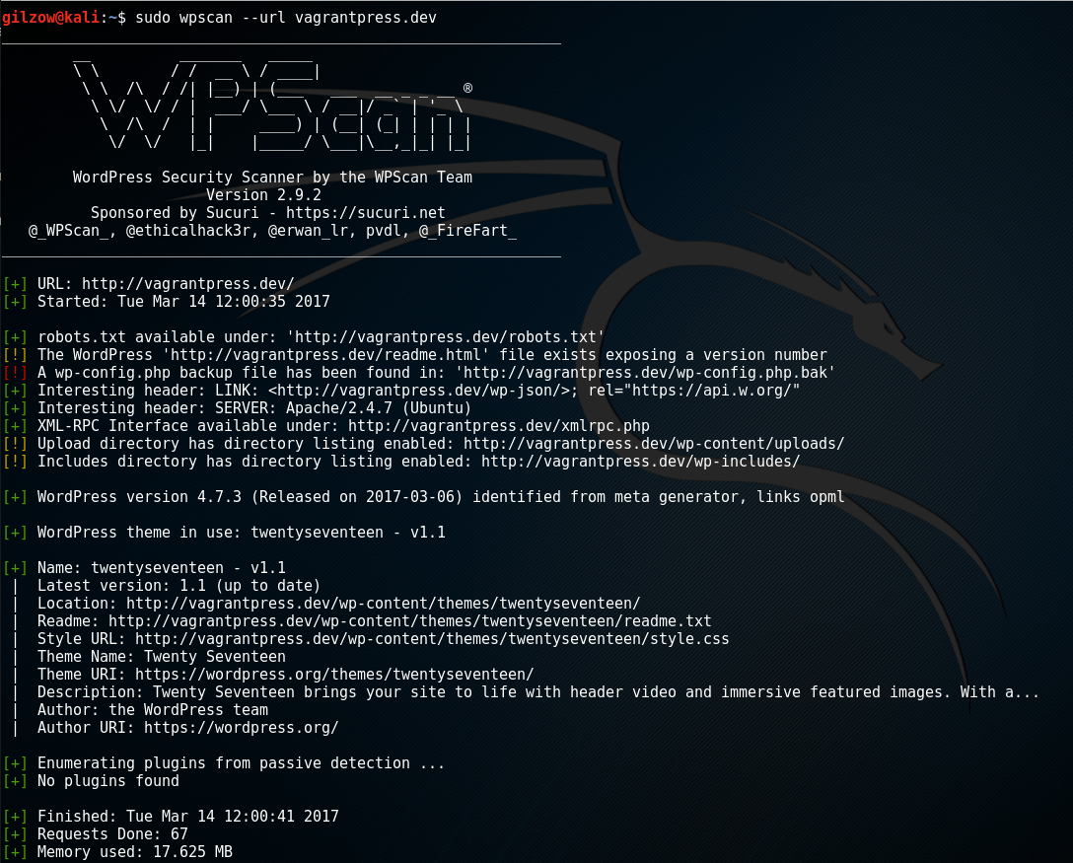
Notes:
also mention .swp in vi/m

Slide 32
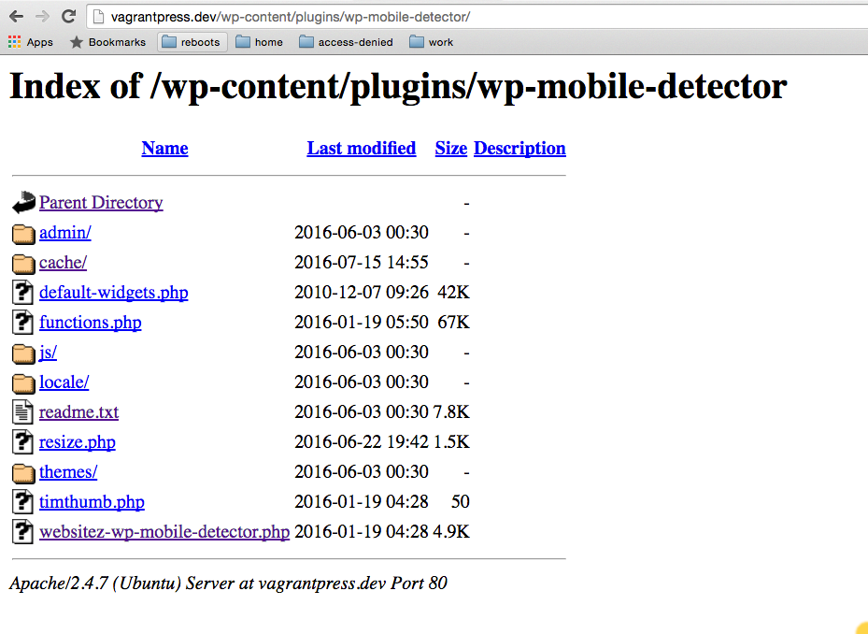

Slide 33
Counter measure
Disable Directory listings
In .htaccess in the root of the site
ask your host to disable in your account
Options -Indexes

Slide 35
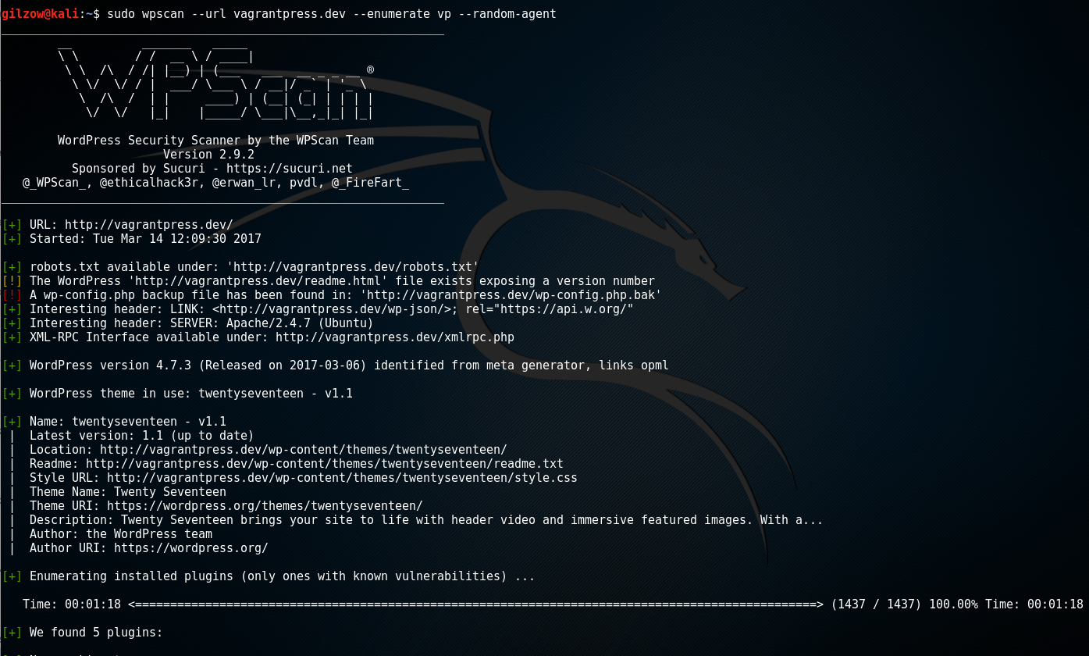


Slide 37
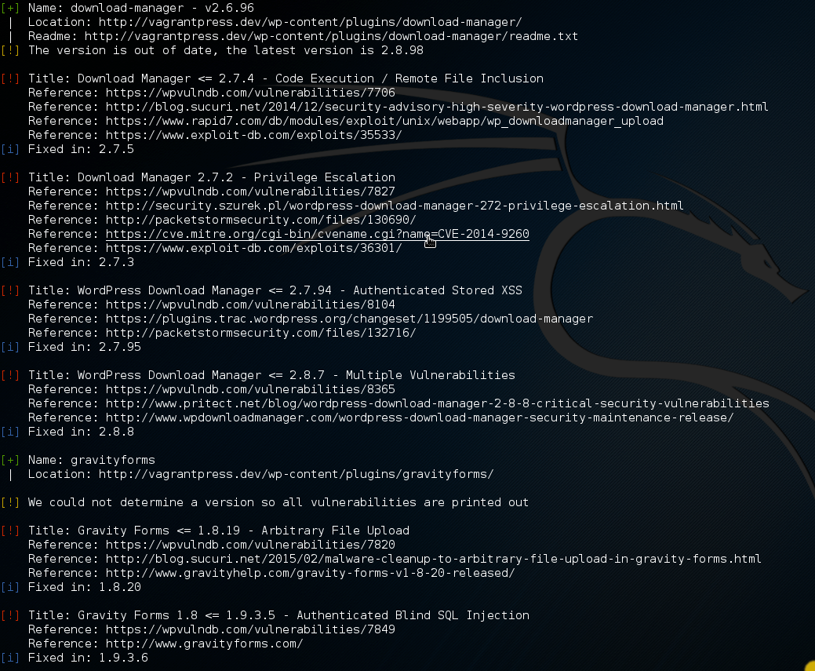
Notes:
CVE - Common Vulnerabilities and Exposures

Slide 38
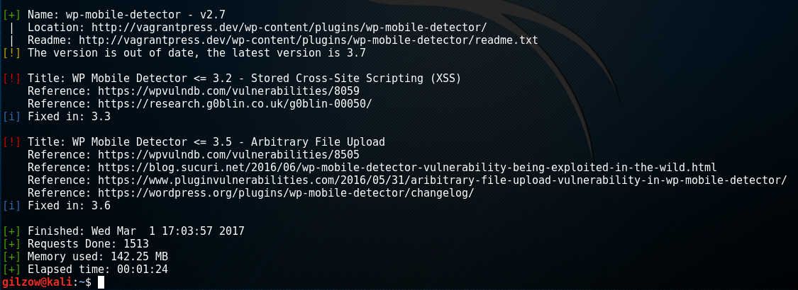
Notes:
January & February 2017 WordPress Attack Report from Wordfence, still in the top 10 attempted exploits

Slide 40
Counter measures
Prevent php execution in /wp-content/uploads/
Notes:
Protect wp-content
Prevent php execution
Implicit deny (only allow what is necessary and expected)
Protect wp-includes
Protect wp-admin
run exploit after showing initial active scan on vagrantpress.dev
do wp-content area first, only blocking php
show how shell wouldn't be accessible, rerun scan
mention how while that blocks execution, can still access read, changeling, etc
next do blocking of everything except white-list, show how everything is blocked but DONT do scan
ask what they think will happen if you run the scan
Add errordocument reroute THEN do scan

Slide 41
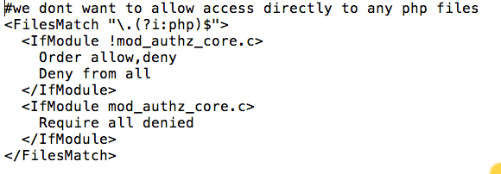
Notes:
mod_authz_core is apache 2.4 and later
Order Allow, Deny
means the default is to deny, and then “allow” for overrides, but then further enable denies to any allows

Slide 42
Counter measures
Prevent php execution in /wp-content/uploads/
Protect wp-content completely
Not only prevent php execution, but
Implicit deny (only allow what is necessary and expected)
Notes:
Protect wp-content
Prevent php execution
Implicit deny (only allow what is necessary and expected)
Protect wp-includes
Protect wp-admin
run exploit after showing initial active scan on vagrantpress.dev
do wp-content area first, only blocking php
show how shell wouldn't be accessible, rerun scan
mention how while that blocks execution, can still access read, changeling, etc
next do blocking of everything except white-list, show how everything is blocked but DONT do scan
ask what they think will happen if you run the scan
Add errordocument reroute THEN do scan

Slide 43
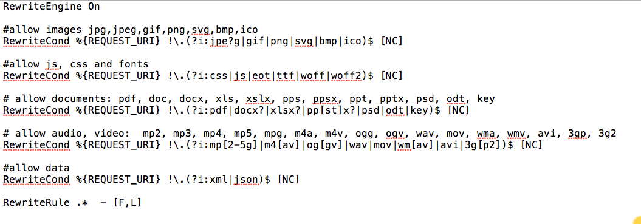
Notes:
[NC] = nocase, case-insensitive

Slide 44
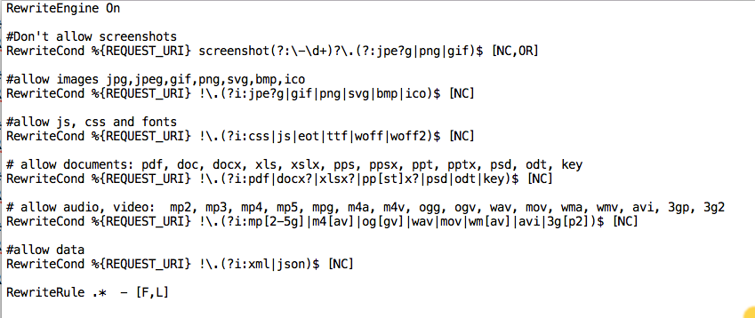

Slide 45
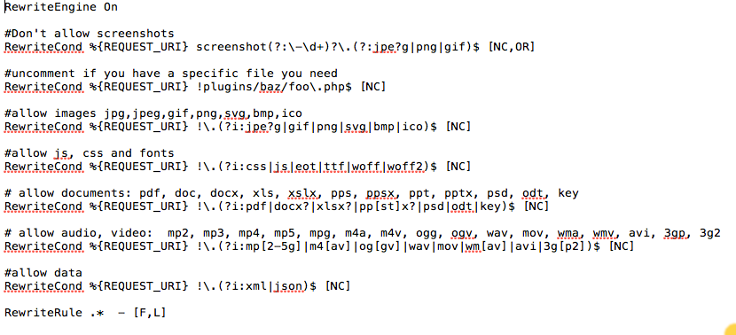

Slide 46
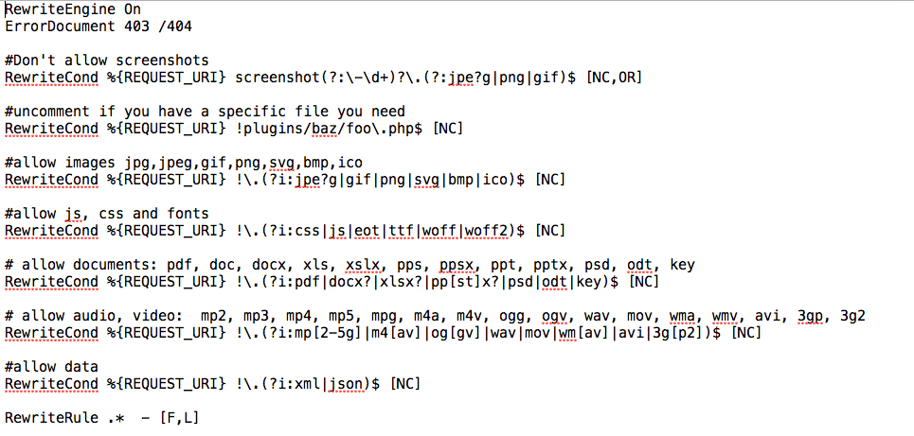


Slide 47
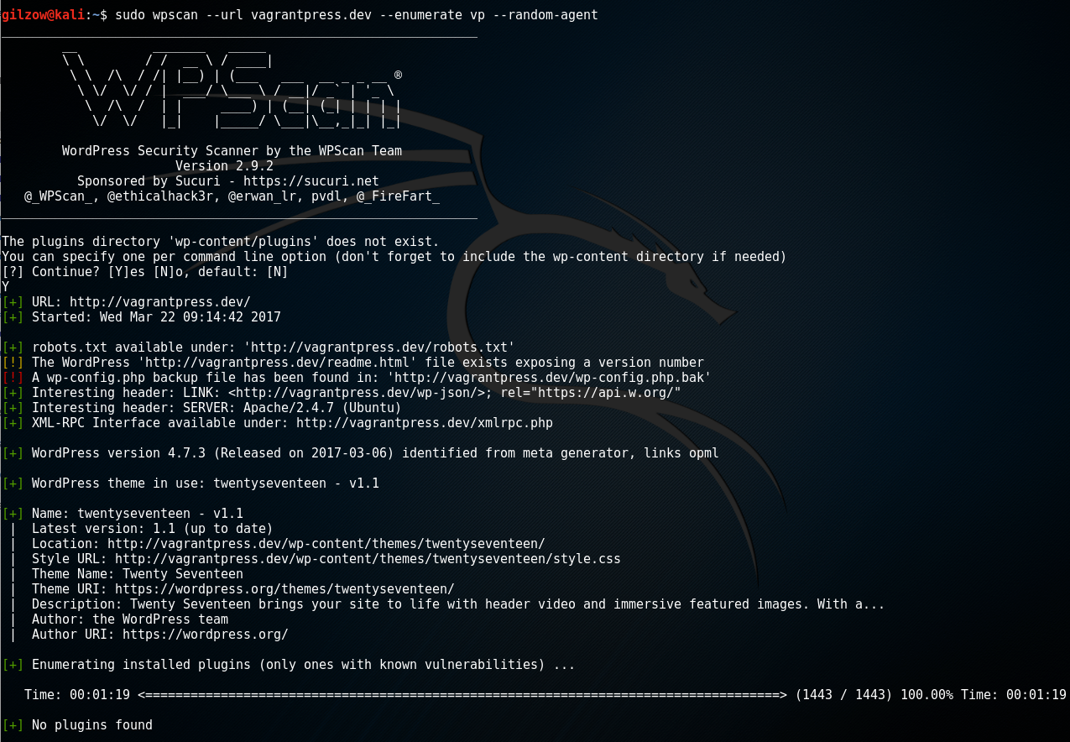

Slide 48
Counter measures
Protect wp-content
Prevent php execution
Implicit deny (only allow what is necessary and expected)
Protect wp-includes
Notes:
Protect wp-content
Prevent php execution
Implicit deny (only allow what is necessary and expected)
Protect wp-includes
Protect wp-admin
run exploit after showing initial active scan on vagrantpress.dev
do wp-content area first, only blocking php
show how shell wouldn't be accessible, rerun scan
mention how while that blocks execution, can still access read, changeling, etc
next do blocking of everything except white-list, show how everything is blocked but DONT do scan
ask what they think will happen if you run the scan
Add errordocument reroute THEN do scan

Slide 49
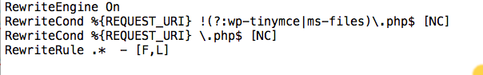

Slide 50
Counter measures
Protect wp-content
Prevent php execution
Implicit deny (only allow what is necessary and expected)
Protect wp-includes
Protect wp-admin
Notes:
Protect wp-content
Prevent php execution
Implicit deny (only allow what is necessary and expected)
Protect wp-includes
Protect wp-admin
run exploit after showing initial active scan on vagrantpress.dev
do wp-content area first, only blocking php
show how shell wouldn't be accessible, rerun scan
mention how while that blocks execution, can still access read, changeling, etc
next do blocking of everything except white-list, show how everything is blocked but DONT do scan
ask what they think will happen if you run the scan
Add errordocument reroute THEN do scan

Slide 51
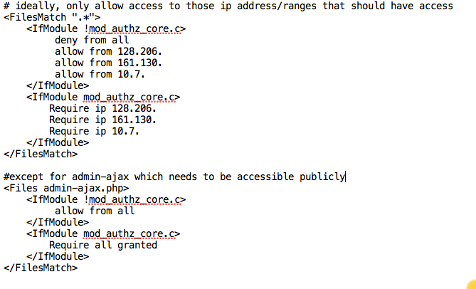
Notes:
tunnelbear.com

Slide 52
64.85.59.68 —> 64.85.0.0/16
Notes:
tunnelbear.com

Slide 53
Notes:
tunnelbear.com

Slide 54
Notes:
tunnelbear.com

Slide 55
Counter measures
Protect wp-content
Prevent php execution
Implicit deny (only allow what is necessary and expected)
Protect wp-includes
Protect wp-admin
Protect the root
Notes:
Protect wp-content
Prevent php execution
Implicit deny (only allow what is necessary and expected)
Protect wp-includes
Protect wp-admin
run exploit after showing initial active scan on vagrantpress.dev
do wp-content area first, only blocking php
show how shell wouldn't be accessible, rerun scan
mention how while that blocks execution, can still access read, changeling, etc
next do blocking of everything except white-list, show how everything is blocked but DONT do scan
ask what they think will happen if you run the scan
Add errordocument reroute THEN do scan

Slide 56
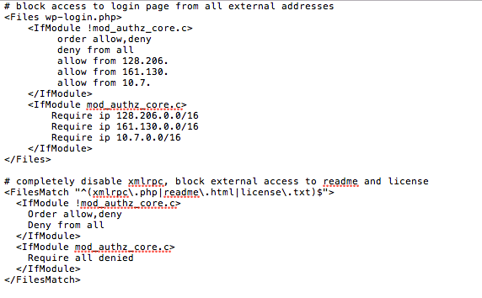
Notes:
https://jetpack.com/support/hosting-faq/ for jetpack ip ranges
<Files xmlrpc.php>
order allow, deny
deny from all
allow from 192.0.64. or 192.0.64.0/18
</Files>

Slide 58
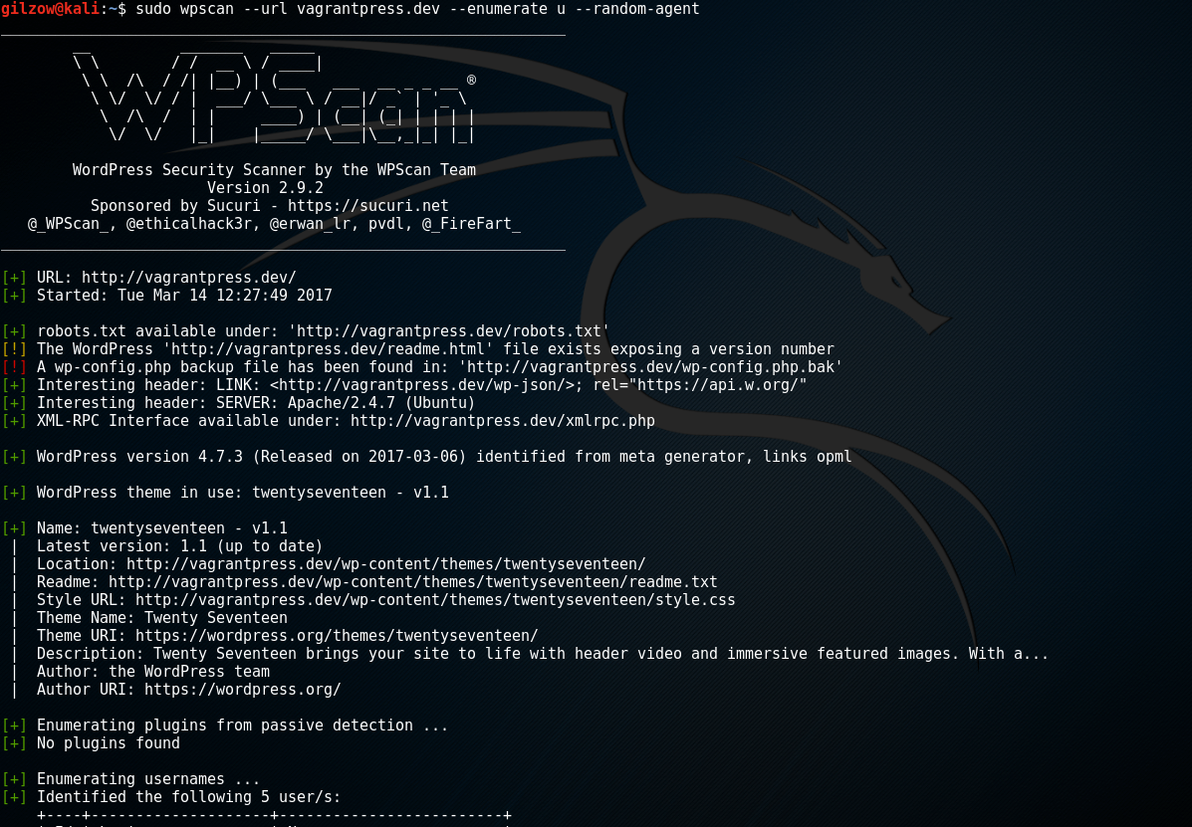
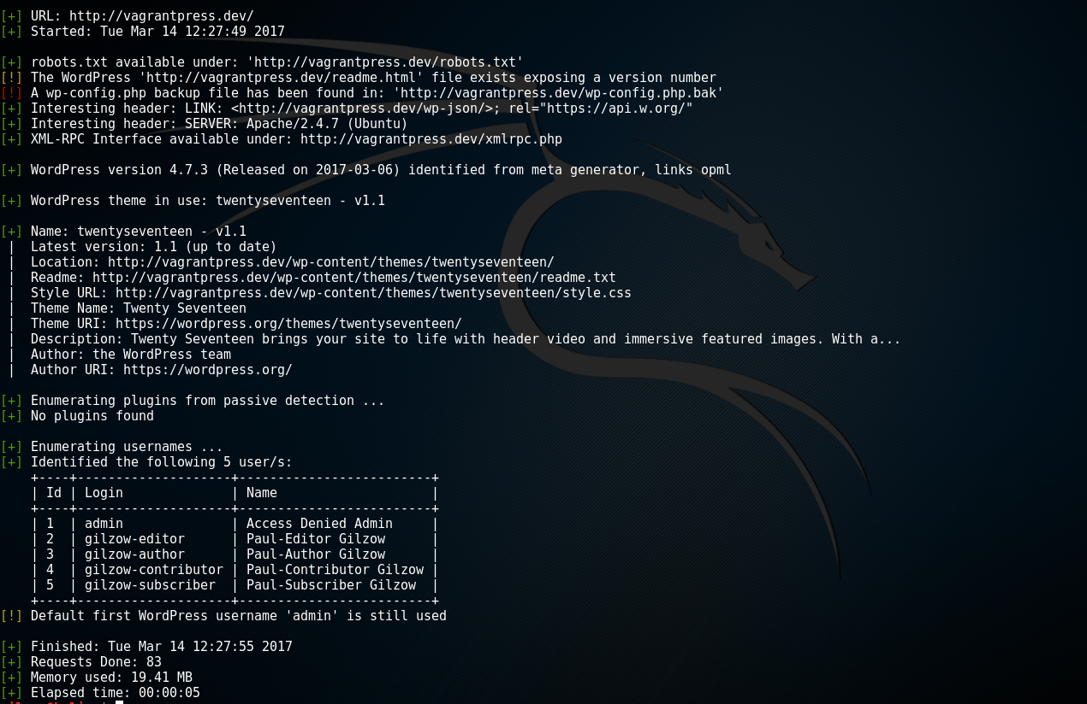

Slide 59
Counter measures
Account enumeration
Prevent ?author= redirection
Notes:
Prevent ?author= redirection
Disable account name as author permalink
Remove author account from classes
Remove default login failure error messages
Debate on whether account enumeration prevention is important
Even more important is strong passwords for every account
Block brute force attempts and mention xmlrpc
also mention that it’s possible for people to log in using email address and email addresses are EVERYWHERE, especially in education
Mention using school’s SSOID system

Slide 60
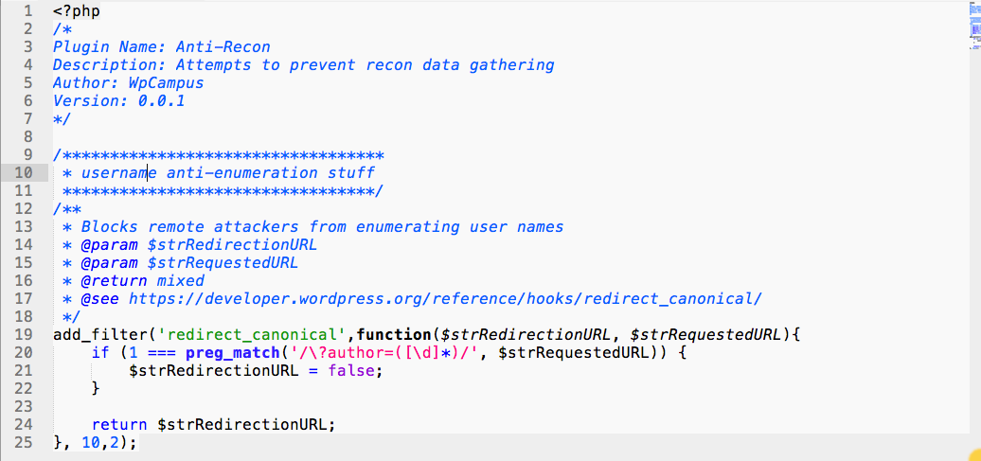

Slide 62
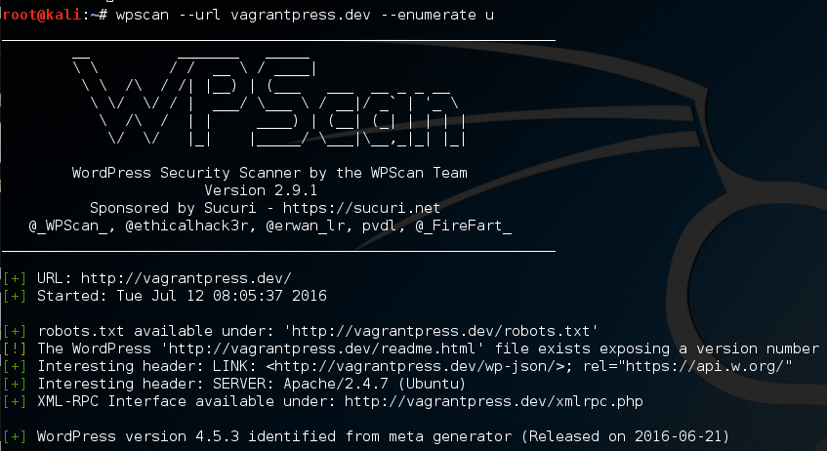
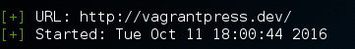
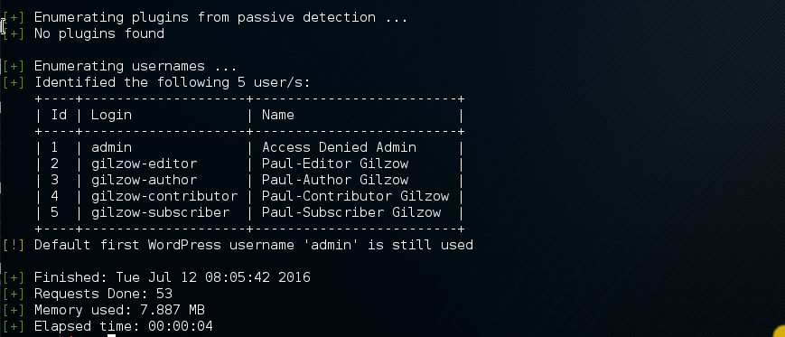
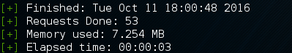

Slide 63
Counter measures
Account enumeration
Prevent ?author= redirection
Disable account name as author permalink
Notes:
Prevent ?author= redirection
Disable account name as author permalink
Remove author account from classes
Remove default login failure error messages
Debate on whether account enumeration prevention is important
Even more important is strong passwords for every account
Block brute force attempts and mention xmlrpc
also mention that it’s possible for people to log in using email address and email addresses are EVERYWHERE, especially in education
Mention using school’s SSOID system

Slide 64
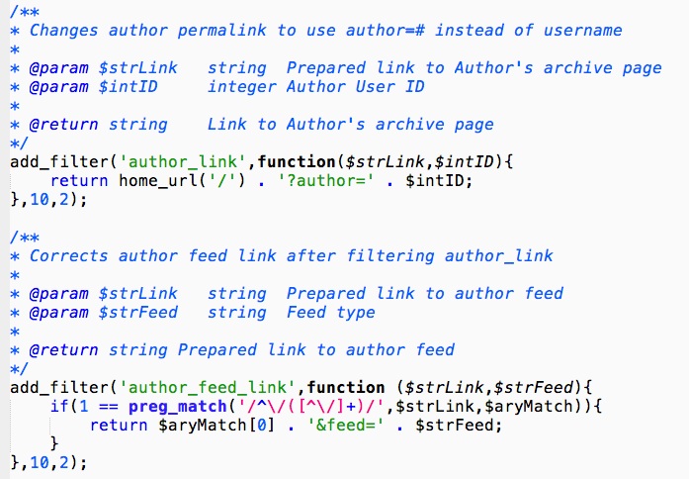

Slide 66


Slide 67
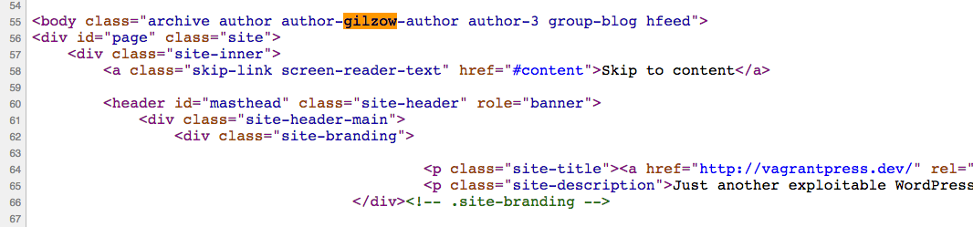

Slide 68
Counter measures
Account enumeration
Prevent ?author= redirection
Disable account name as author permalink
Remove author account from classes
Notes:
Prevent ?author= redirection
Disable account name as author permalink
Remove author account from classes
Remove default login failure error messages
Debate on whether account enumeration prevention is important
Even more important is strong passwords for every account
Block brute force attempts and mention xmlrpc
also mention that it’s possible for people to log in using email address and email addresses are EVERYWHERE, especially in education
Mention using school’s SSOID system

Slide 69
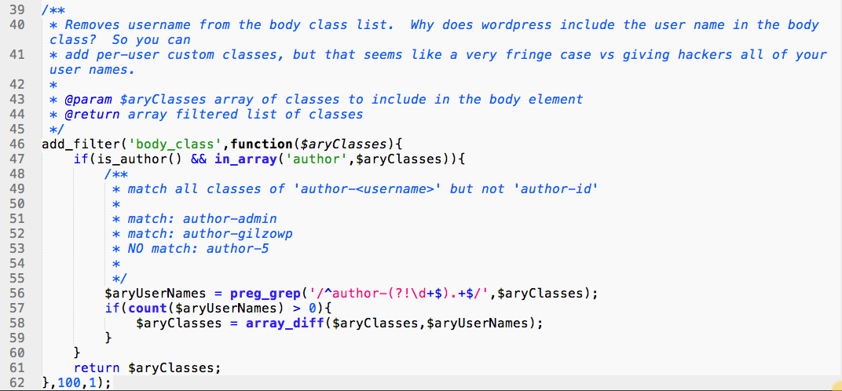

Slide 70
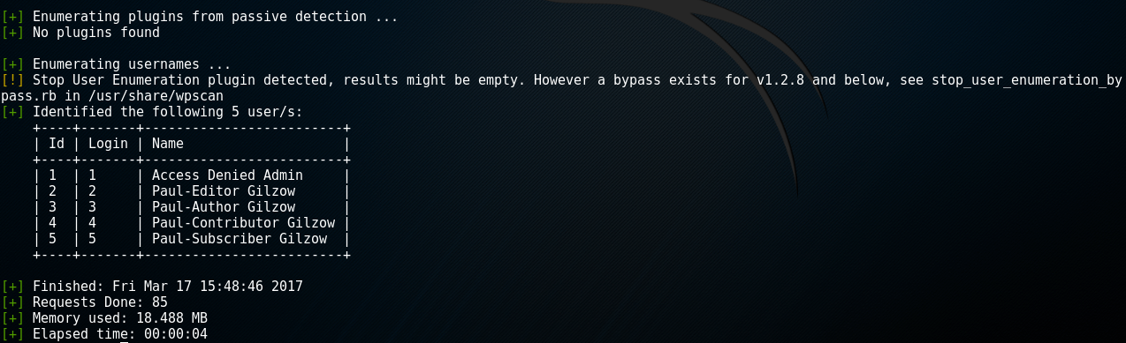

Slide 72


Slide 73
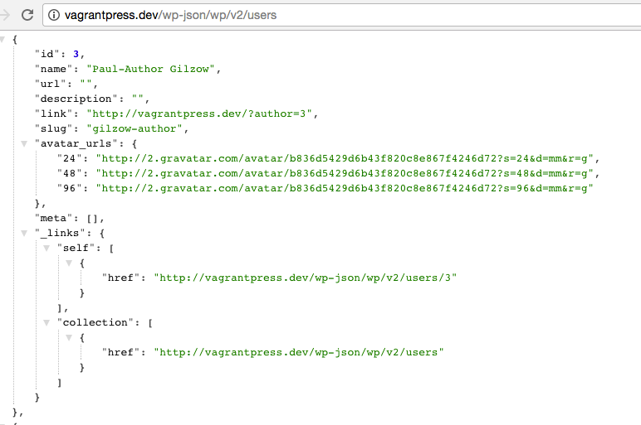


Slide 74
Counter measures
Account enumeration
Prevent ?author= redirection
Disable account name as author permalink
Remove author account from classes
Remove user “slug” property from users endpoint in REST API
Notes:
Prevent ?author= redirection
Disable account name as author permalink
Remove author account from classes
Remove default login failure error messages
Debate on whether account enumeration prevention is important
Even more important is strong passwords for every account
Block brute force attempts and mention xmlrpc
also mention that it’s possible for people to log in using email address and email addresses are EVERYWHERE, especially in education
Mention using school’s SSOID system

Slide 75
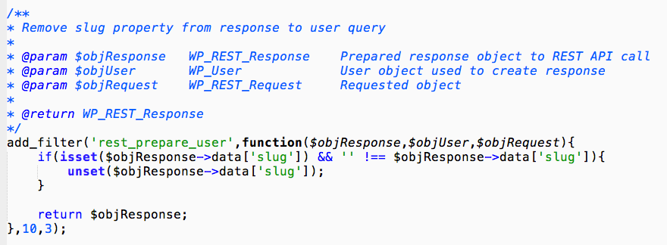

Slide 76
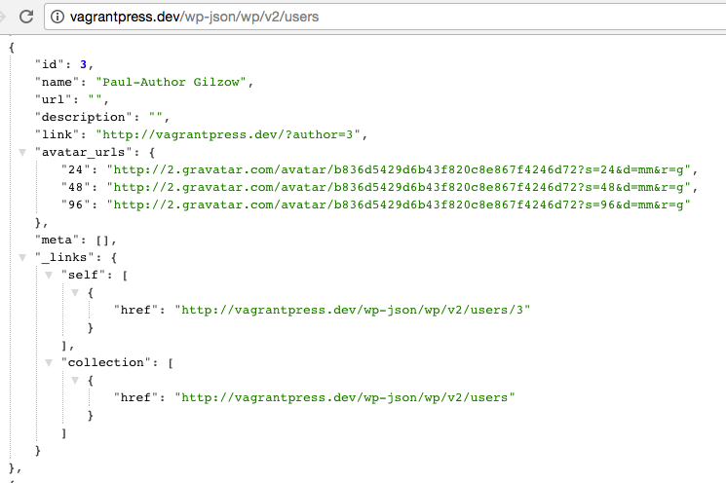

Slide 77
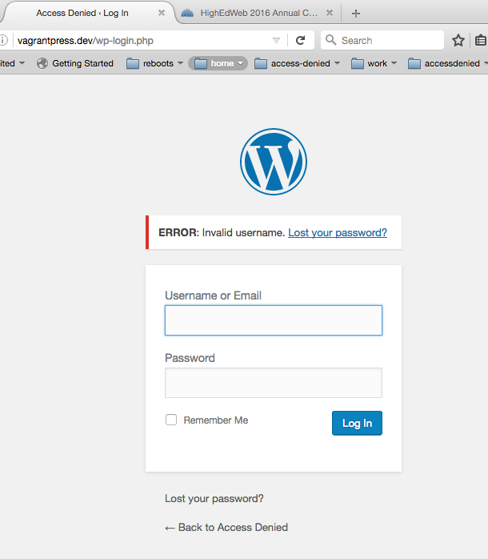

Slide 78
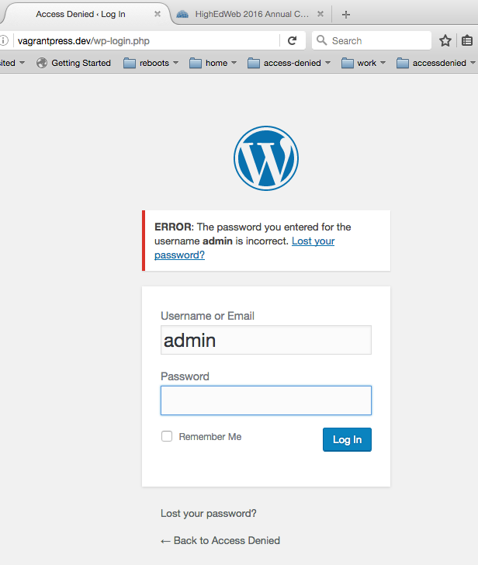

Slide 79
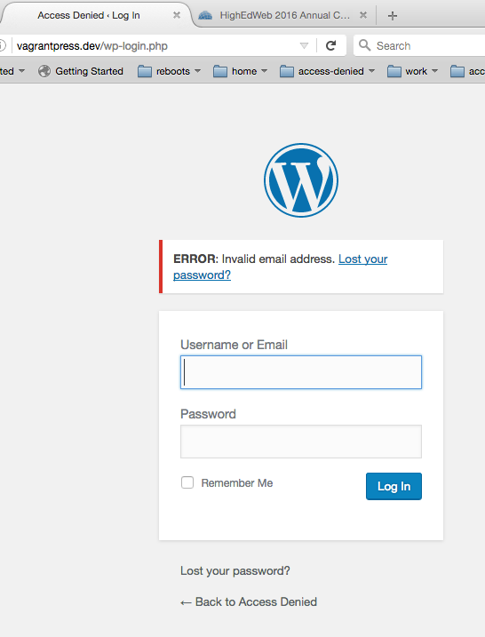

Slide 80
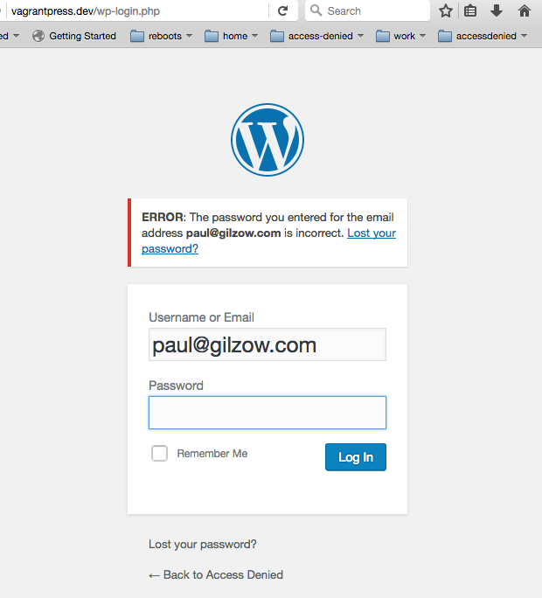

Slide 81


Slide 82
Counter measures
Account enumeration
Prevent ?author= redirection
Disable account name as author permalink
Remove author account from classes
Remove users endpoint from REST API
Remove default login failure error messages
Notes:
Prevent ?author= redirection
Disable account name as author permalink
Remove author account from classes
Remove default login failure error messages
Debate on whether account enumeration prevention is important
Even more important is strong passwords for every account
Block brute force attempts and mention xmlrpc
also mention that it’s possible for people to log in using email address and email addresses are EVERYWHERE, especially in education
Mention using school’s SSOID system

Slide 83
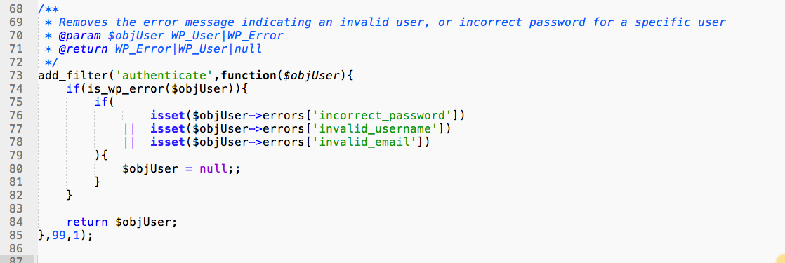

Slide 84
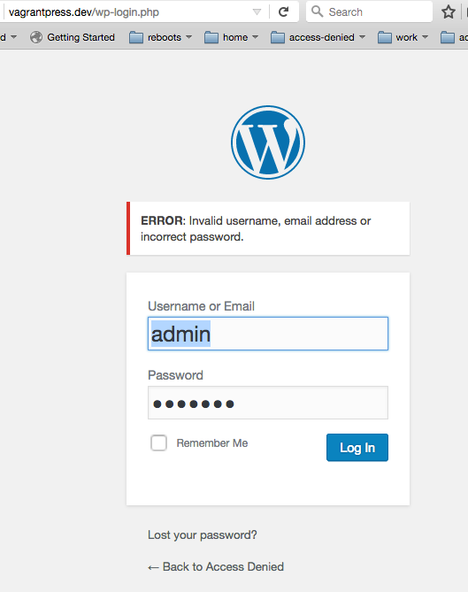

Slide 85
Counter measures
Account enumeration
Prevent ?author= redirection
Disable account name as author permalink
Remove author account from classes
Remove default login failure error messages
Notes:
Prevent ?author= redirection
Disable account name as author permalink
Remove author account from classes
Remove default login failure error messages
Debate on whether account enumeration prevention is important
Even more important is strong passwords for every account
Block brute force attempts and mention xmlrpc
also mention that it’s possible for people to log in using email address and email addresses are EVERYWHERE, especially in education
Mention using school’s SSOID system

Slide 86
additional Counter measures
Limit access to wp-login.php and /wp-admin/
Disable file editing
Lock down wp-config.php
Limit or disable xmlrpc
Hide wordpress version
if(!defined('DISALLOW_FILE_EDIT')){
define('DISALLOW_FILE_EDIT', TRUE);
}
Notes:
xmlrpc
- ddos attacks
- bruteforce
directories
find /path/to/your/wordpress/install/ -type d -exec chmod 755 {} \;
files
find /path/to/your/wordpress/install/ -type f -exec chmod 644 {} \;

Slide 87
More extreme Counter measures
Use suPHP, php-fpm
Prevent php from being able to write to files
Move wp-config.php
Move plugin and theme locations
Notes:
xmlrpc
- ddos attacks
- bruteforce
directories
find /path/to/your/wordpress/install/ -type d -exec chmod 755 {} \;
files
find /path/to/your/wordpress/install/ -type f -exec chmod 644 {} \;

Slide 88
additional things to consider
Log everything and analyze those logs

Slide 89
Counter measures
Make sure you have directory listing disabled
Prevent PHP execution where it shouldn’t happen
User account names
XML-RPC

Slide 90
Summary
Be paranoid; be skeptical
Uninstall plugins/themes that aren’t in use
Disable php from executing where it shouldn’t
Limit access to everything where you can

Slide 91
Summary cont.
In other words…
Implicitly deny
Defense-in-depth

Slide 92
“[Security is a] continuously moving target… that requires constant vigilance to understand and appreciate.”
Tony Perez, @perezbox
Notes:
what we cover/discuss today might not be relevant next year

Slide 93
With ease of use and extensibility, comes a responsibility.
Tony Perez, @perezbox

Slide 94
What questions do
You Have for me?

Slide 95
Contact
Contact
gilzow@missouri.edu
@gilzow on twitter
gilzow on wordpress.org
Files: https://github.com/gilzow/access-denied/, wcmia2017 branch
Additional tools that are handy
BuiltWith.com
Wappalyzer (Firefox, Chrome, Opera + bookmarklet)

